Slide 1
Document Name:
Data Classification: Internal
Disclaimer
The contents of this document are property of Softtek, and are classified as Internal. Any reproduction in whole or in part is strictly prohibited without the written permission of Softtek.
This document is subject to change. Comments, corrections or questions should be directed to the author.
Audience / Viewership | Purpose
Revision Chart
The following chart list the revisions made to this document. Use this to describe the changes and additions each time this document is re-published. The description should be detailed as possible and include the names of the reviewers who request the changes.
Version No. | Version date | Types of changes | Owner / Author | Date of review / Expiration

Slide 2
Cryptocurrency Analysis
Esteban Barranco, Gerardo Guzmán, Daniel Vera, Miguel Ramírez, Uzmar Gómez
November 18, 2019

Slide 3
Project goals and objectives
To provide finantial information about different cryptocurrencies
To develop both a timeseries prediction and a portfolio of this cryptocurrencies
To inform of the expected return percentage of a certain investment
To use an algorithm that could be implemented for different markets

Slide 4
App presentation

Slide 5




Technology and Tools
Python
Flask
Docker
MongoDB
SQL

Slide 6

Time series algorithm Facebook Prophet
Uses a forecasting model
It has three main components:
Trend (Linear or Logistic)
Seasonality (Based on a Fourier Series)
Holidays
An error term

Slide 7
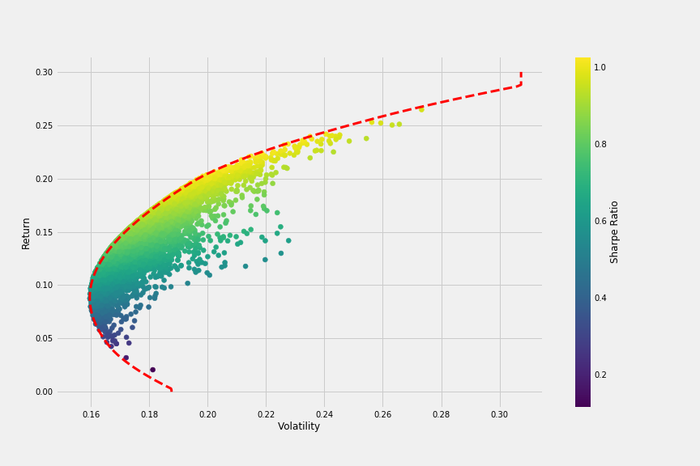
Portfolio
Modern theory of Harry Markowitz. The investor must approach the portfolio as a whole
Selection of an active, passive or structured strategy depend on:
Customer’s visión about market efficiency
Customer risk tolerance
The nature of the client’s liabilities

Slide 8
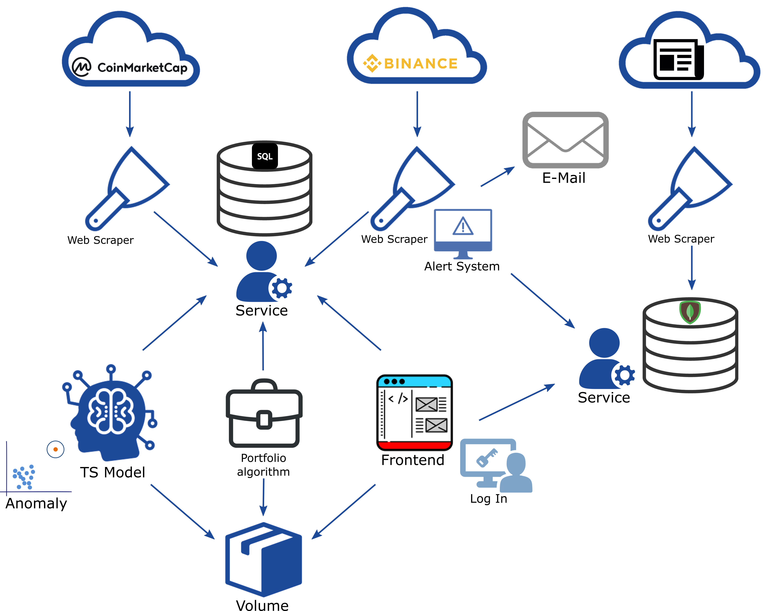
App structure

Slide 9
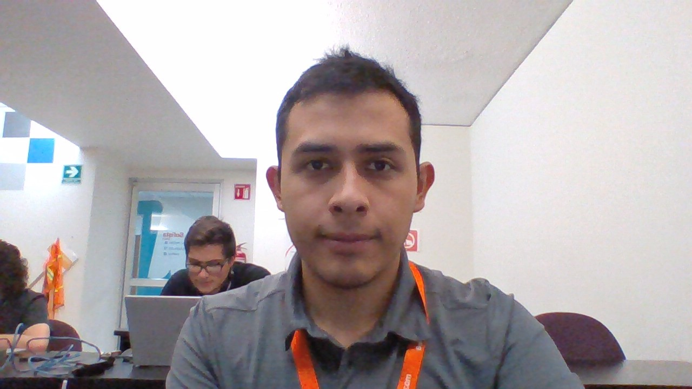
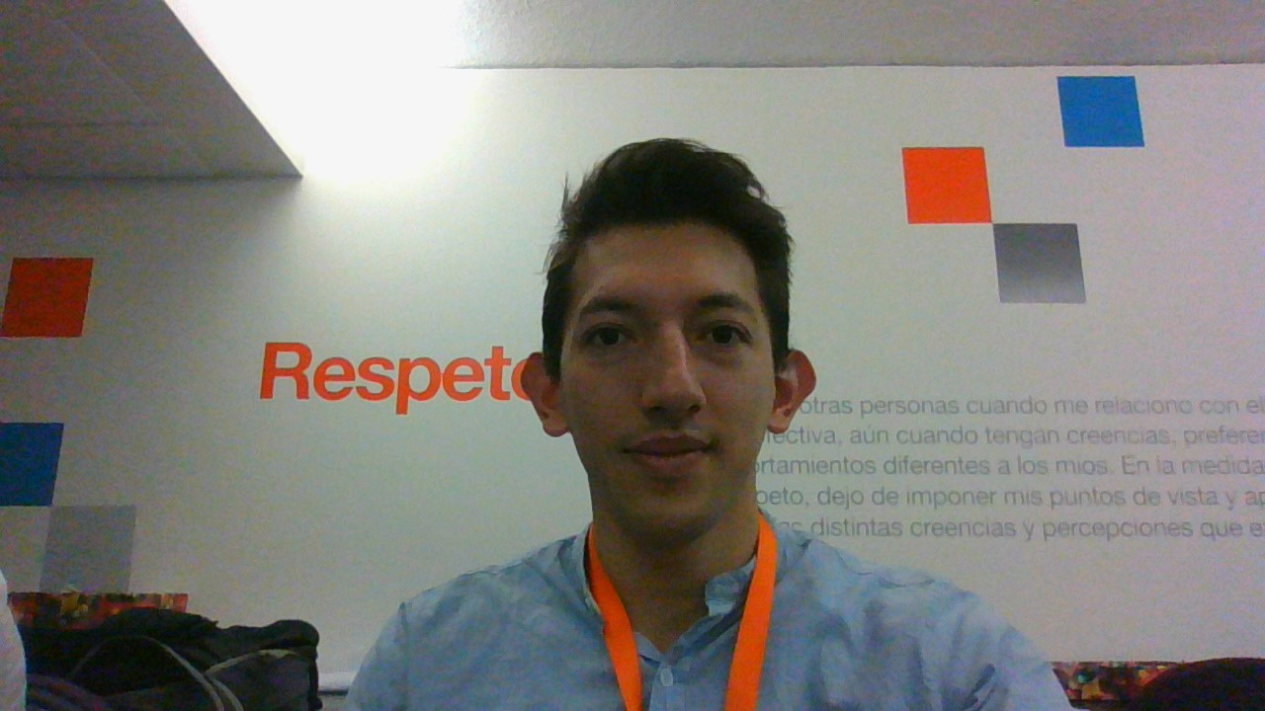
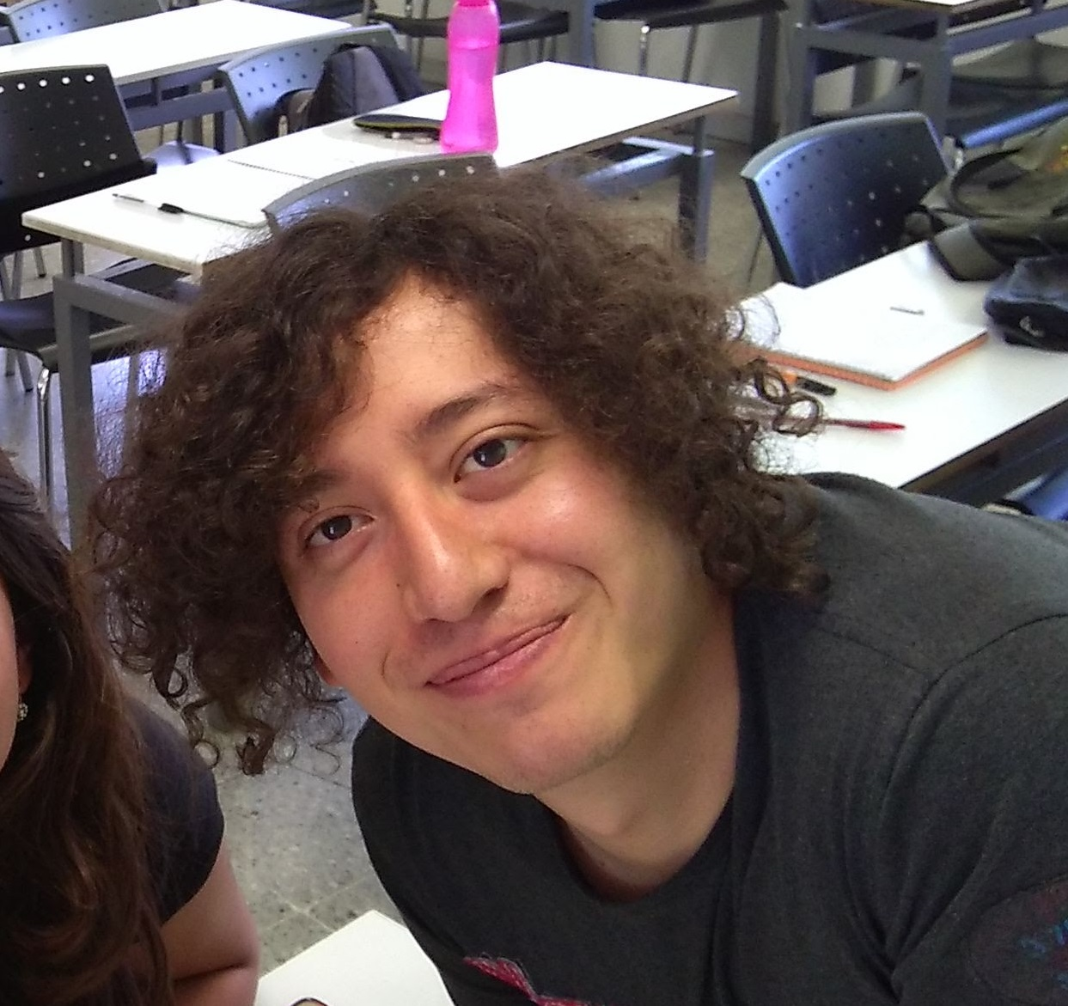
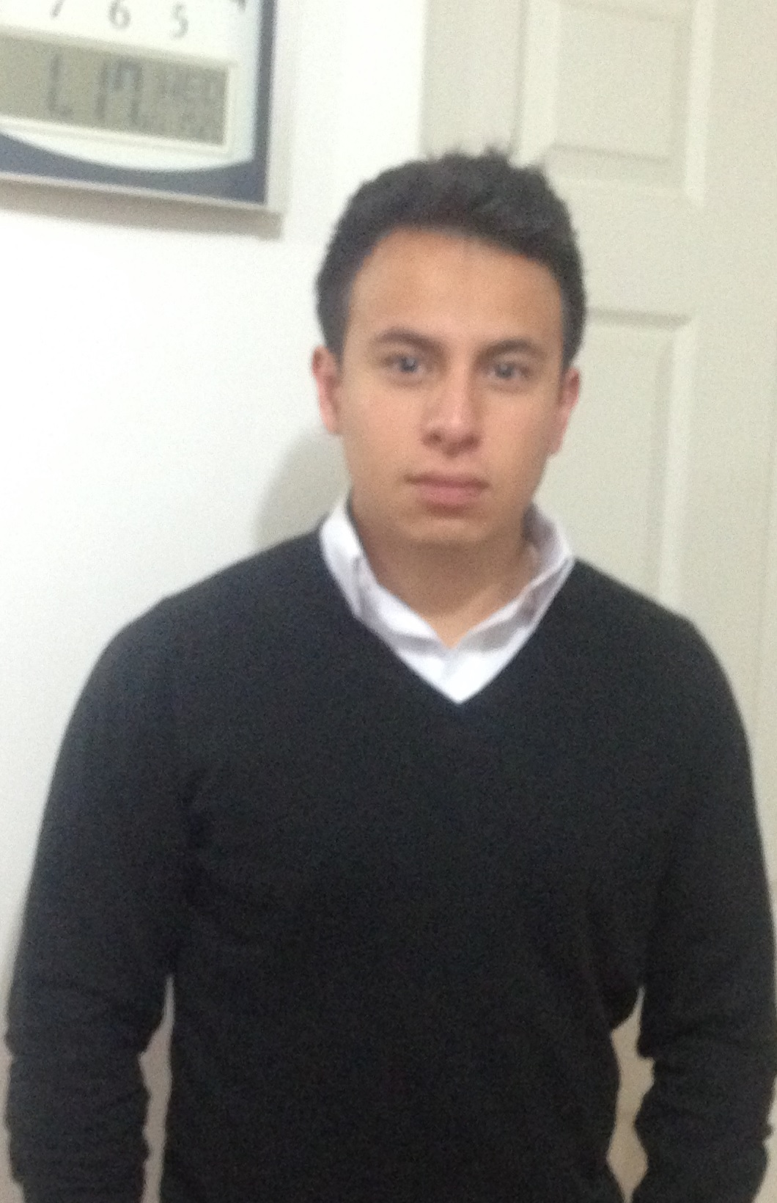
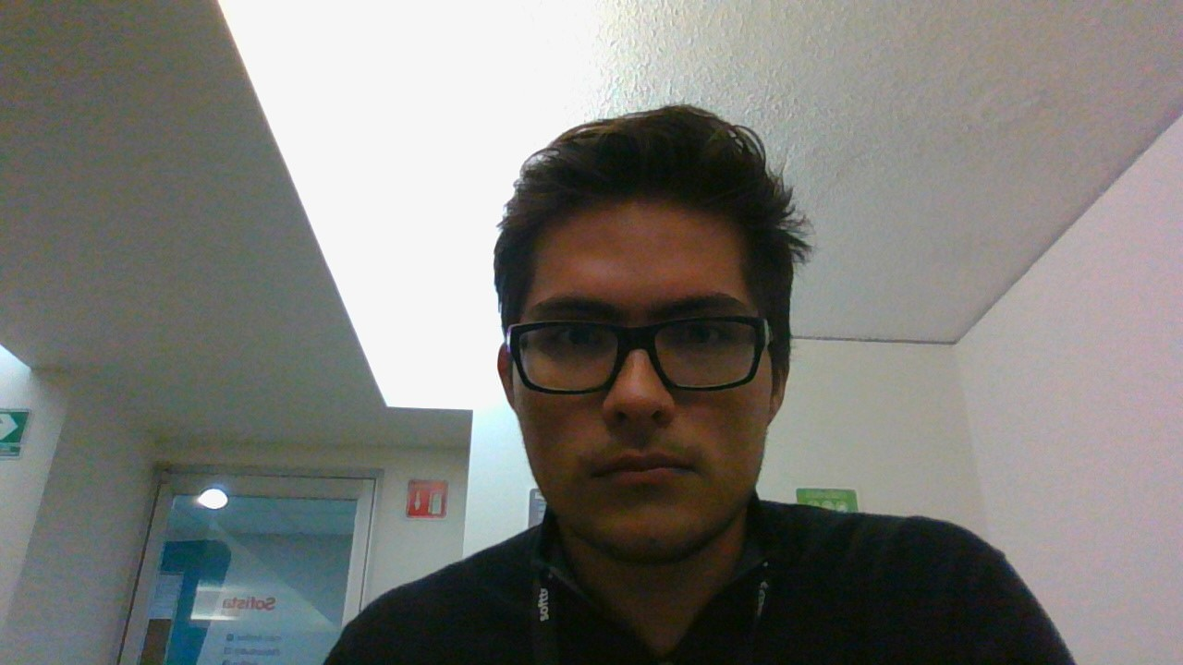
The team
Luis Barranco
BEng. Mechatronics engineering UNAM
- Full stack python developer
- Knowledge of applied AI
- GCP knowledge
Daniel Vera
M.S. in Signal Processing UAM
- Python developer
- Signal processing analysis using AI and ML
- Statistical Data analysis
Uzmar Gómez
BSc Physics UNAM
- C++/Python Developer
- Numerical analysis
Luis Guzmán
BSc Actuarial Science UNAM.
- Python developer
- Data analyst.
- Risk data analyst and model designer.
Miguel Ramírez
BSc Actuarial Science UNAM
- Python developer
- Statistical model designer

